Slide 1
DIP – Final Project Backlight Image Process
組員：柯劭函、游庭維、林宗翰、謝承佑

Slide 2
目標
人物為主角的背光補償
假設光源在後方
假設人物在圖片中央

Slide 3
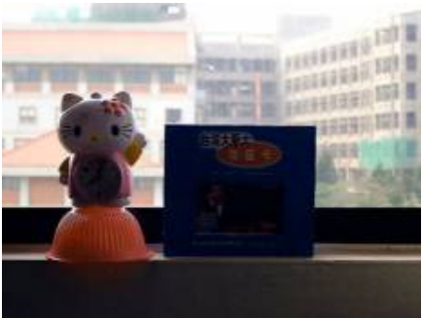
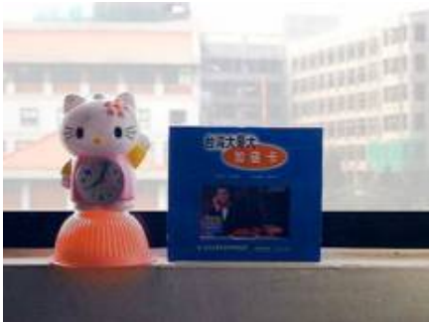
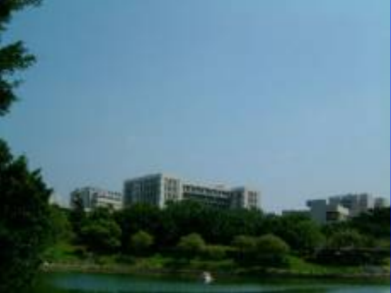
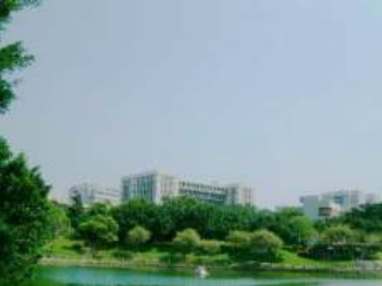
Problem？？

Slide 4
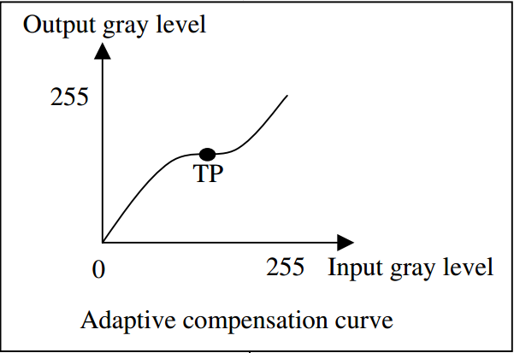
Basic Concept
Input Image
Detect
if backlight or not？
NO
Other Image Problem
Yes
Backlight with high degree
Compensated Image

Slide 5
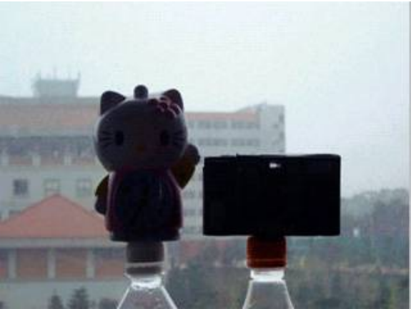
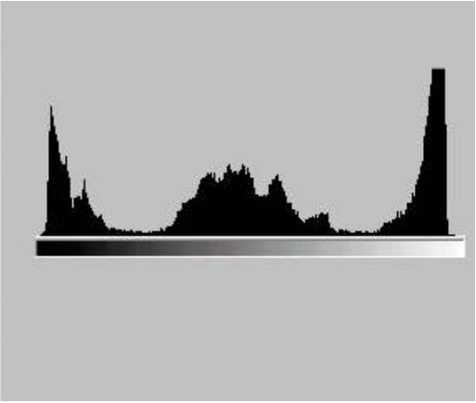
Detection Phase
透過image和histogram兩個方向，使用fuzzy logic得出兩個backlight degree，最後歸納出最後的backlight degree。
Image
Histogram

Slide 6
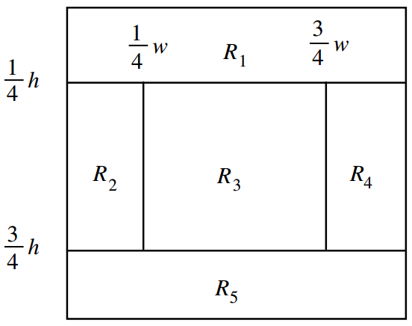
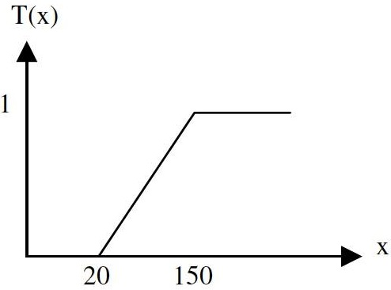
Detection Phase -- Bimage
MRi is the average value of gray level of each area
$$B_{image}=T(\frac{\left[{MR}_{1}+\max\left({MR}_{2},{MR}_{4}\right)\right]}{2}−\frac{\left[{MR}_{3}+{MR}_{5}+\min\left({MR}_{2},{MR}_{4}\right)\right]}{3})$$

Slide 7
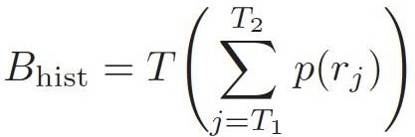
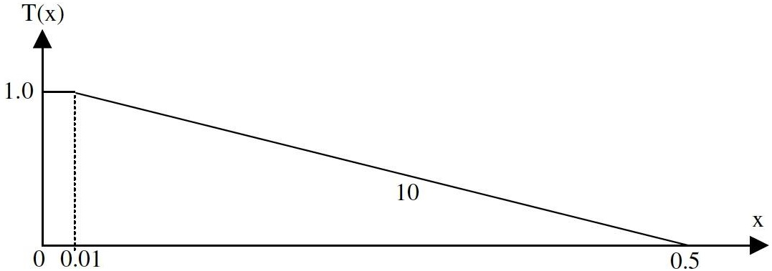
Detection Phase -- Bhist

Slide 8
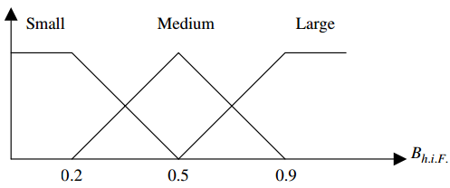
Detection Phase -- Bf
利用fuzzy set統整Bimage和Bhist得到的結果。
藉由fuzzy IF-THEN rules得到fuzzy system output。
Ex: IF Bimage is small and Bhist is small THEN Bf is small
利用COA得出最後的Bf。

Slide 9
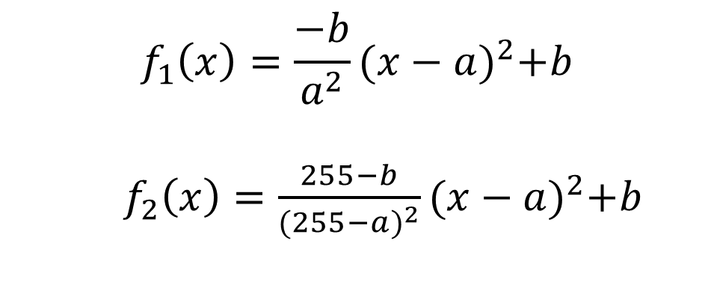
Transformation Function - 1
$$f_{1}\left(x\right)=\frac{−b}{a^{2}}{(x−a)}^{2}+b$$
$f_{2}\left(x\right)=\frac{255−b}{{(255−a)}^{2}}{(x−a)}^{2}+b$

Slide 10
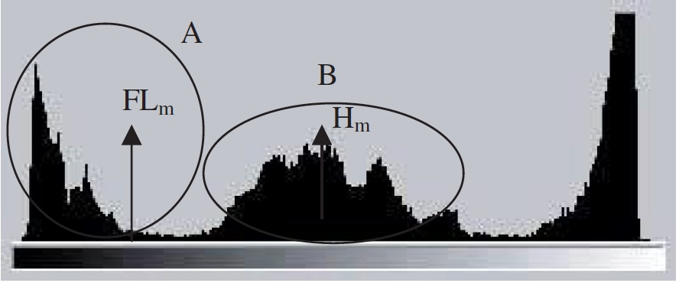
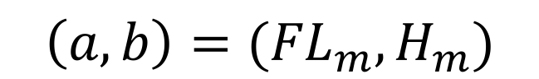
Transformation Function - 2
$$\left(a, b\right)=({FL}_{m}, H_{m})$$

Slide 11
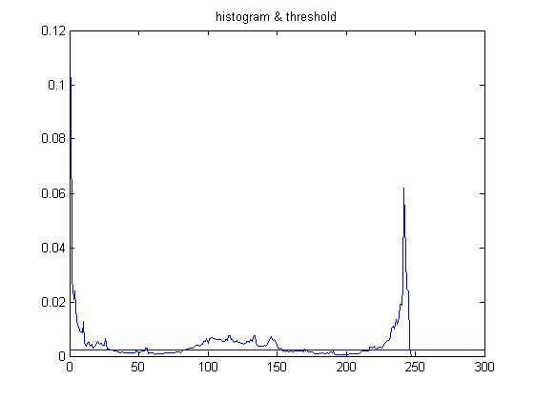
Threshold= 0.0022 Lm = 7.6984 Hm =122.6605 FLm =12.3142
Grouping

Slide 12
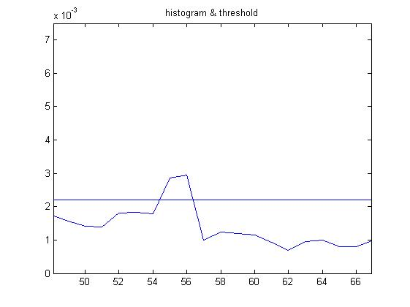
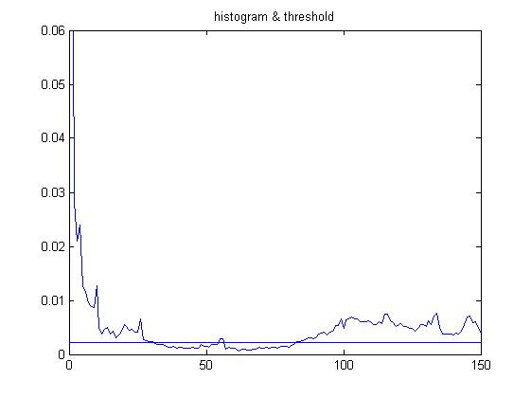
Grouping
規則:
(start, end) 組數不能太多(2~3組)
組不能太小
組之間不能太近

Slide 13
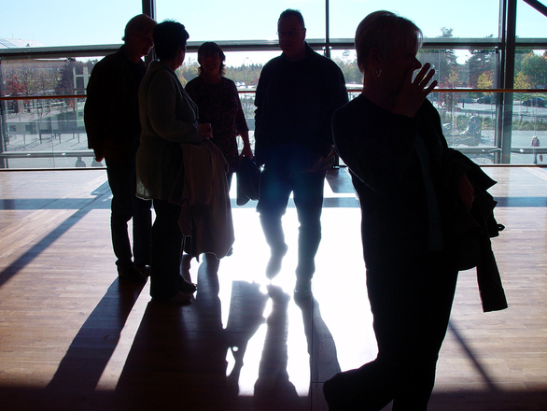
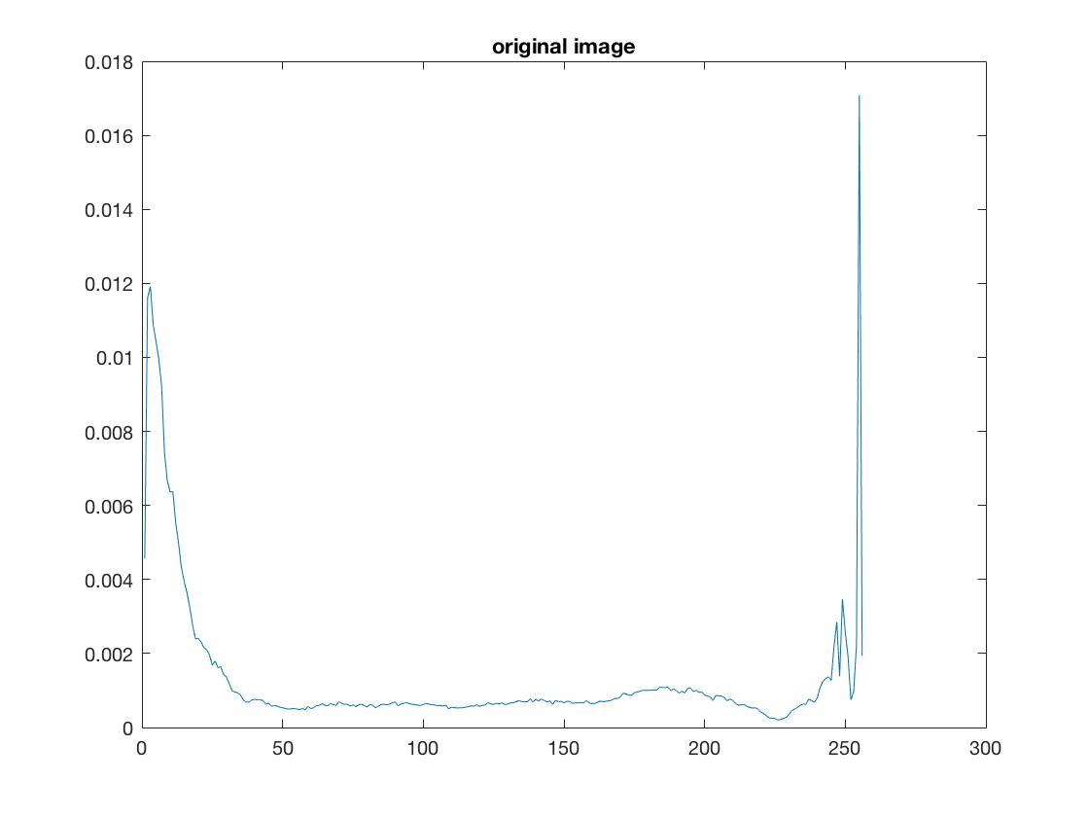
Original image

Slide 14
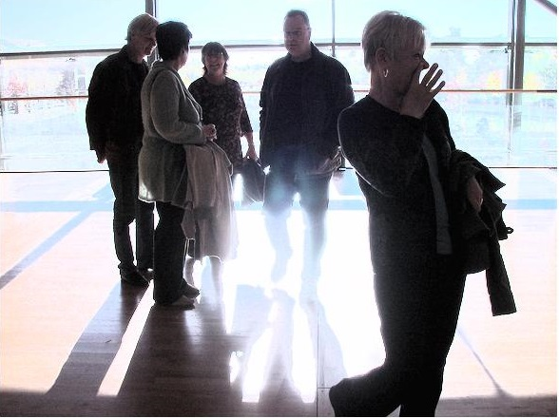
Our method
Histogram equalization

Slide 15
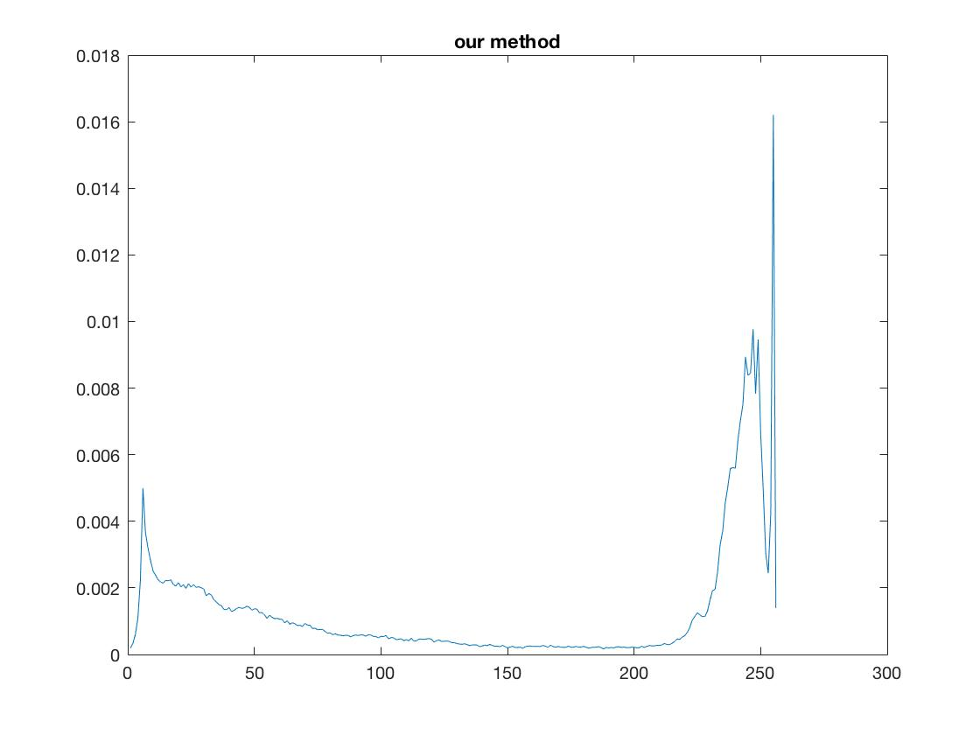
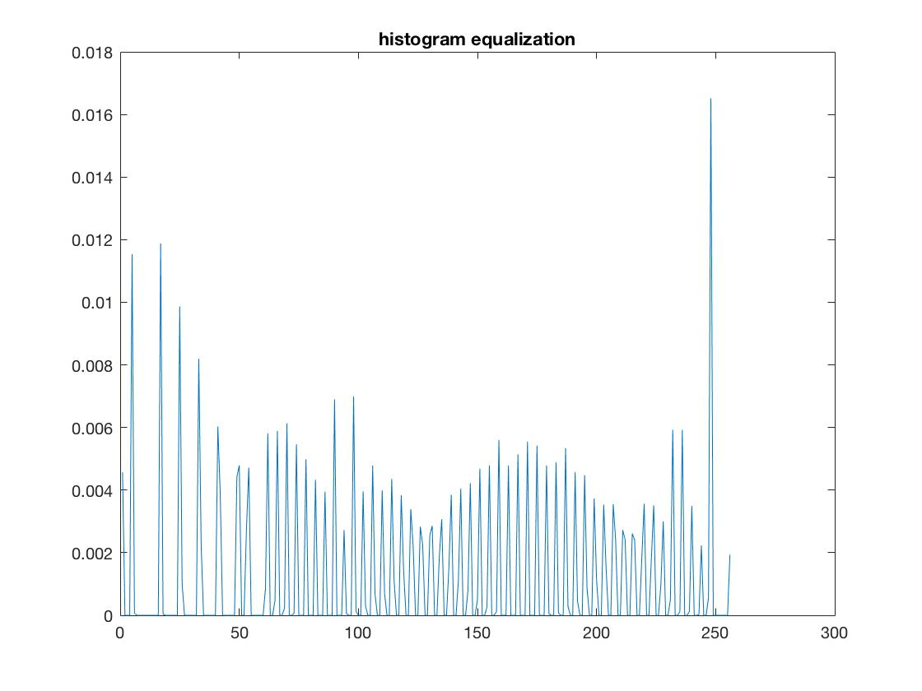
Our method
Histogram equalization

Slide 16

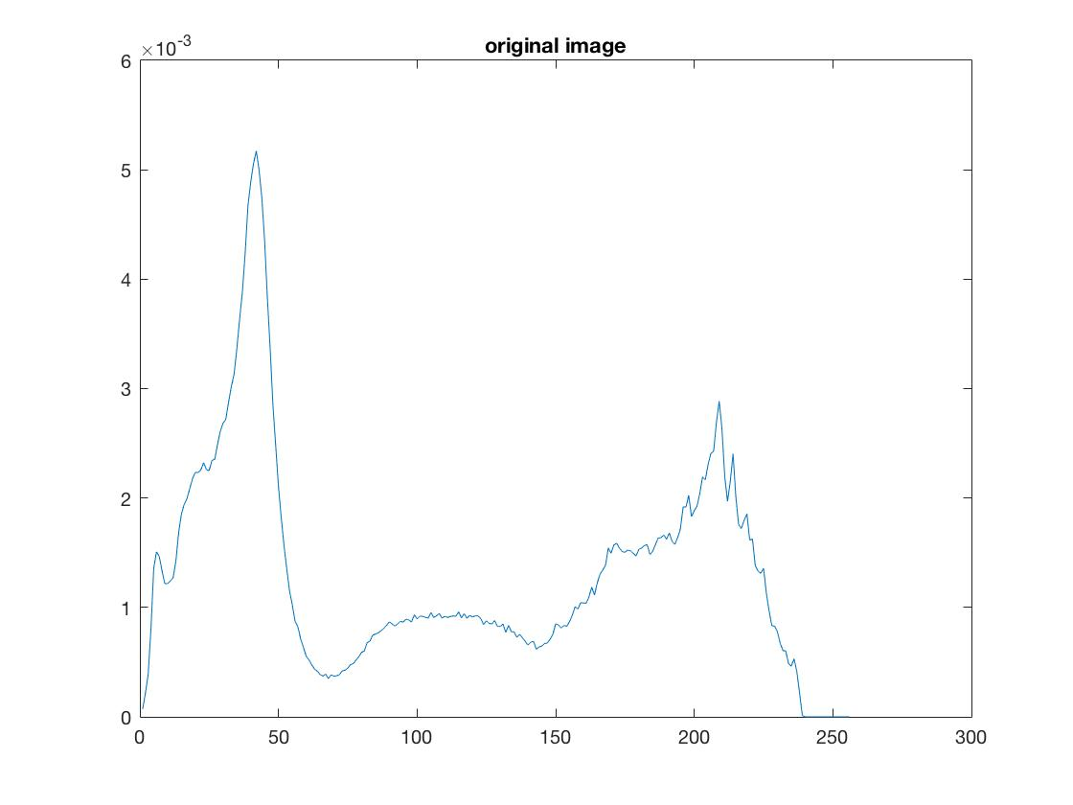
Original image

Slide 17


Our method
Histogram equalization

Slide 18
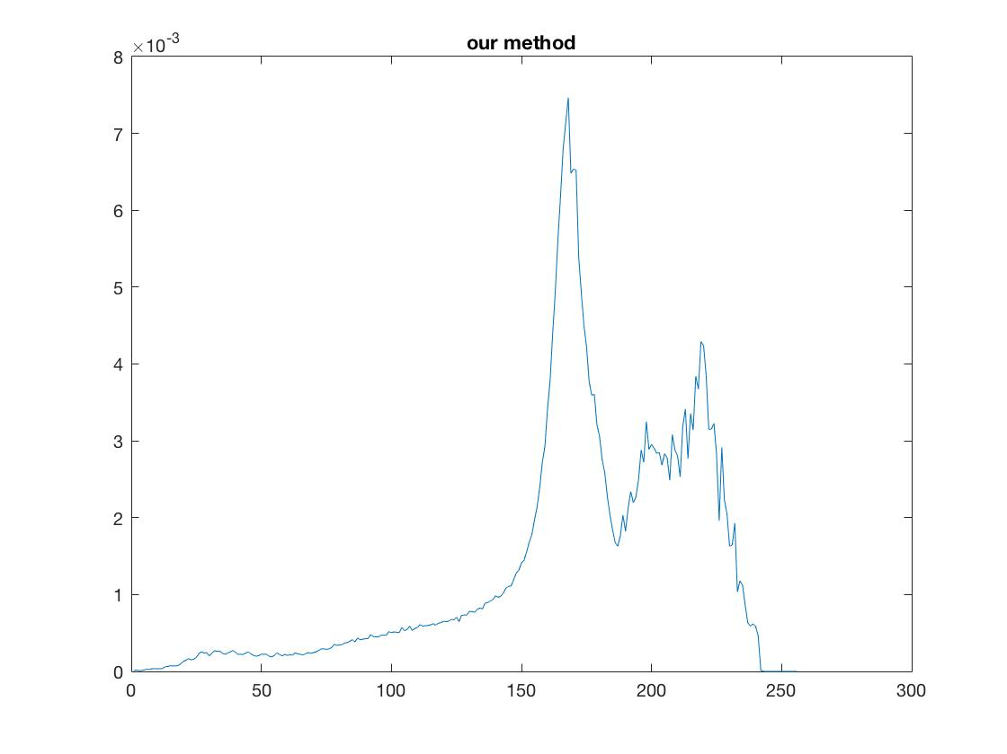
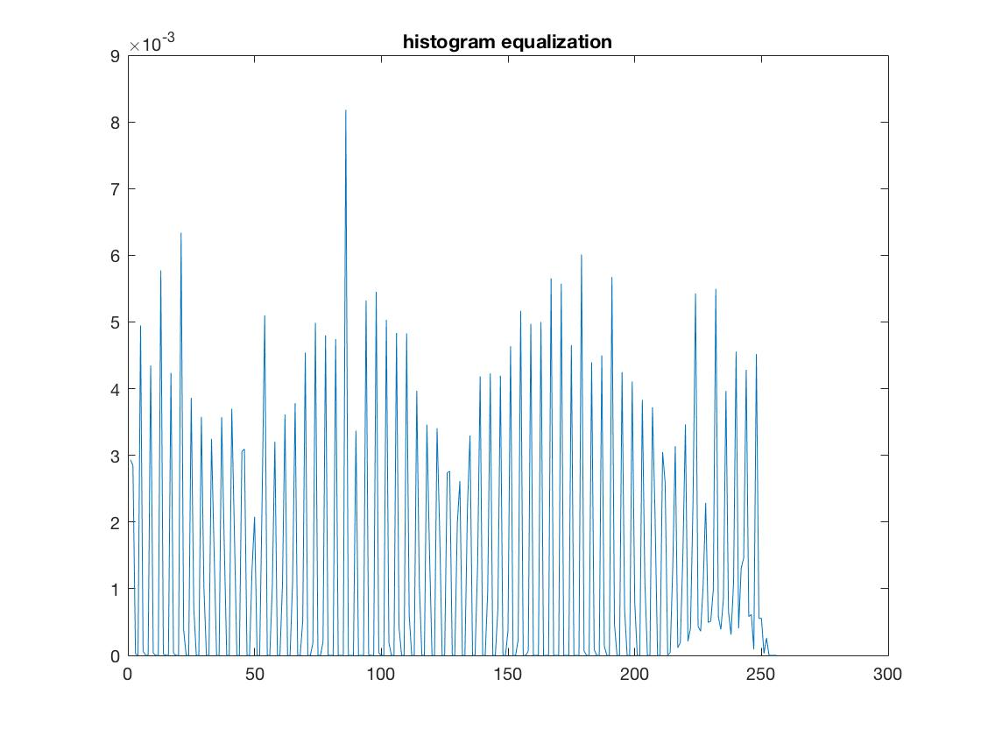
Our method
Histogram equalization

Slide 19


Slide 20

It’s DEMO time！！！

